Slide 1
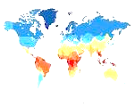
Welcome to a day of prayer, in the company of Brother Charles
a day for reaching out with love to each other
and to all our brothers and sisters
of every continent and situation.

Slide 2
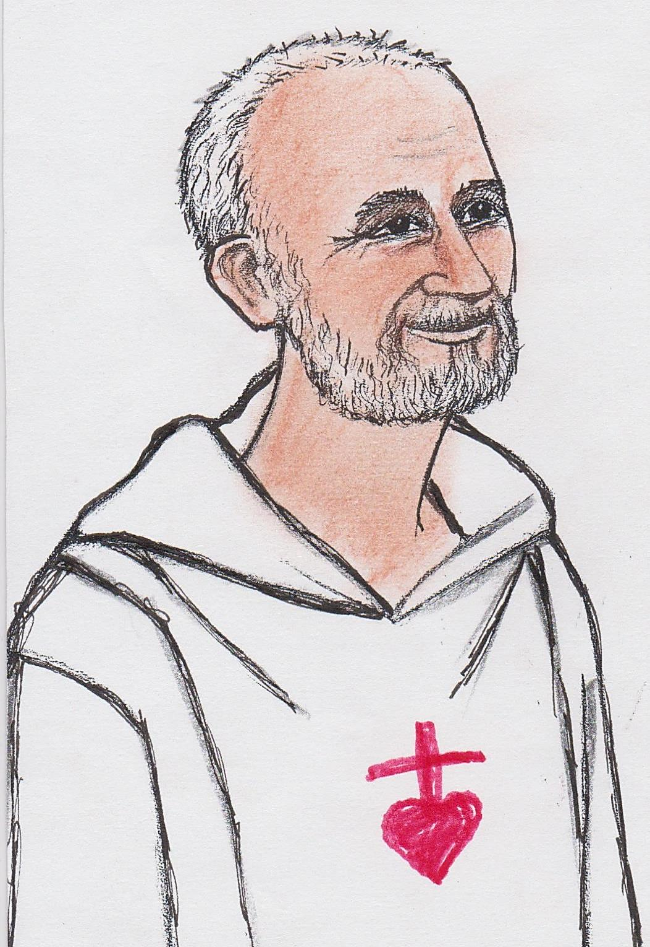
Part 1
Discovering the life and message of Charles de Foucauld.
Blessed Brother Charles of Jesus
Throughout this day we will pray his message together.

Slide 3
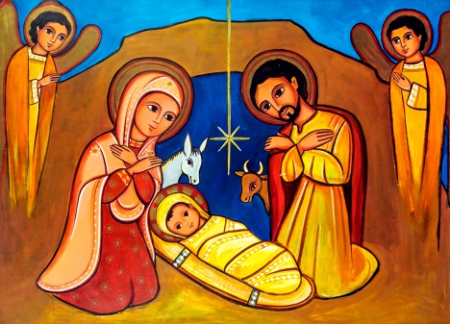
Charles leads us to the simplicity of the Incarnation, to Bethlehem and to Nazareth…

Slide 4
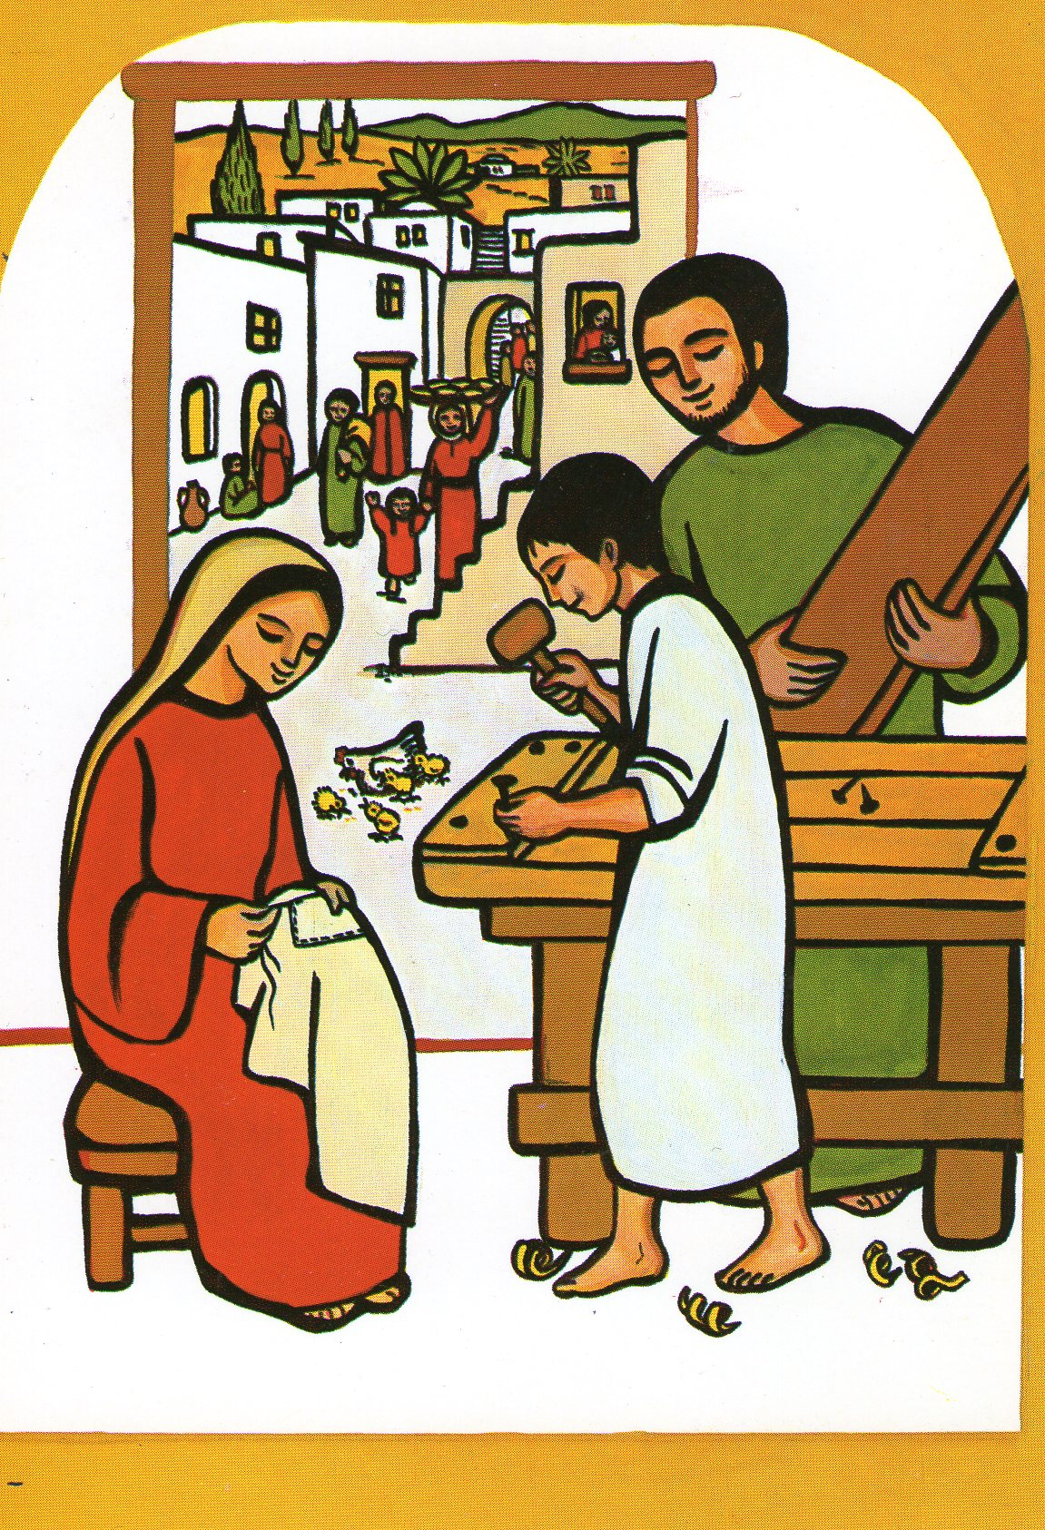
To the mystery of the hidden life,
the every day life,
where we are all called to live as saints…
as Pope Francis tells us.

Slide 5
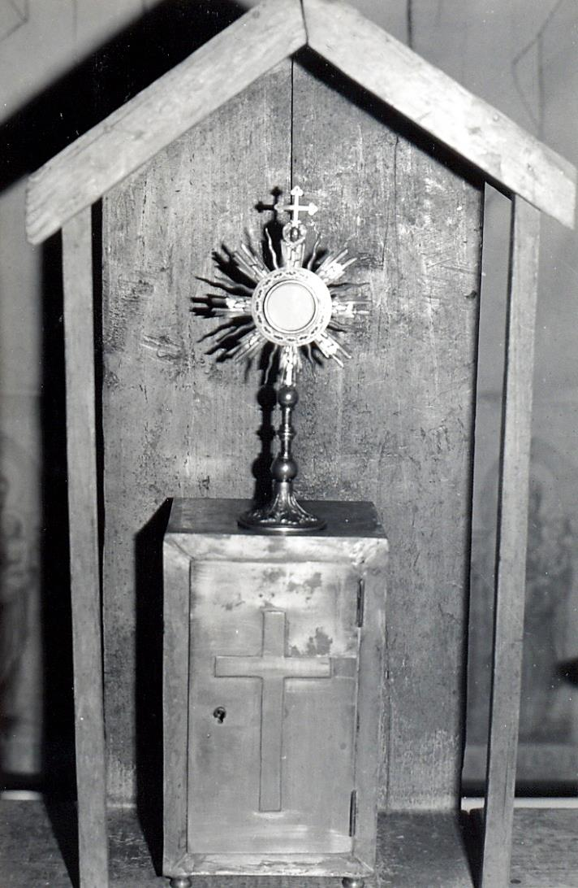
He leads us to finding Jesus in the Eucharist,

Slide 6
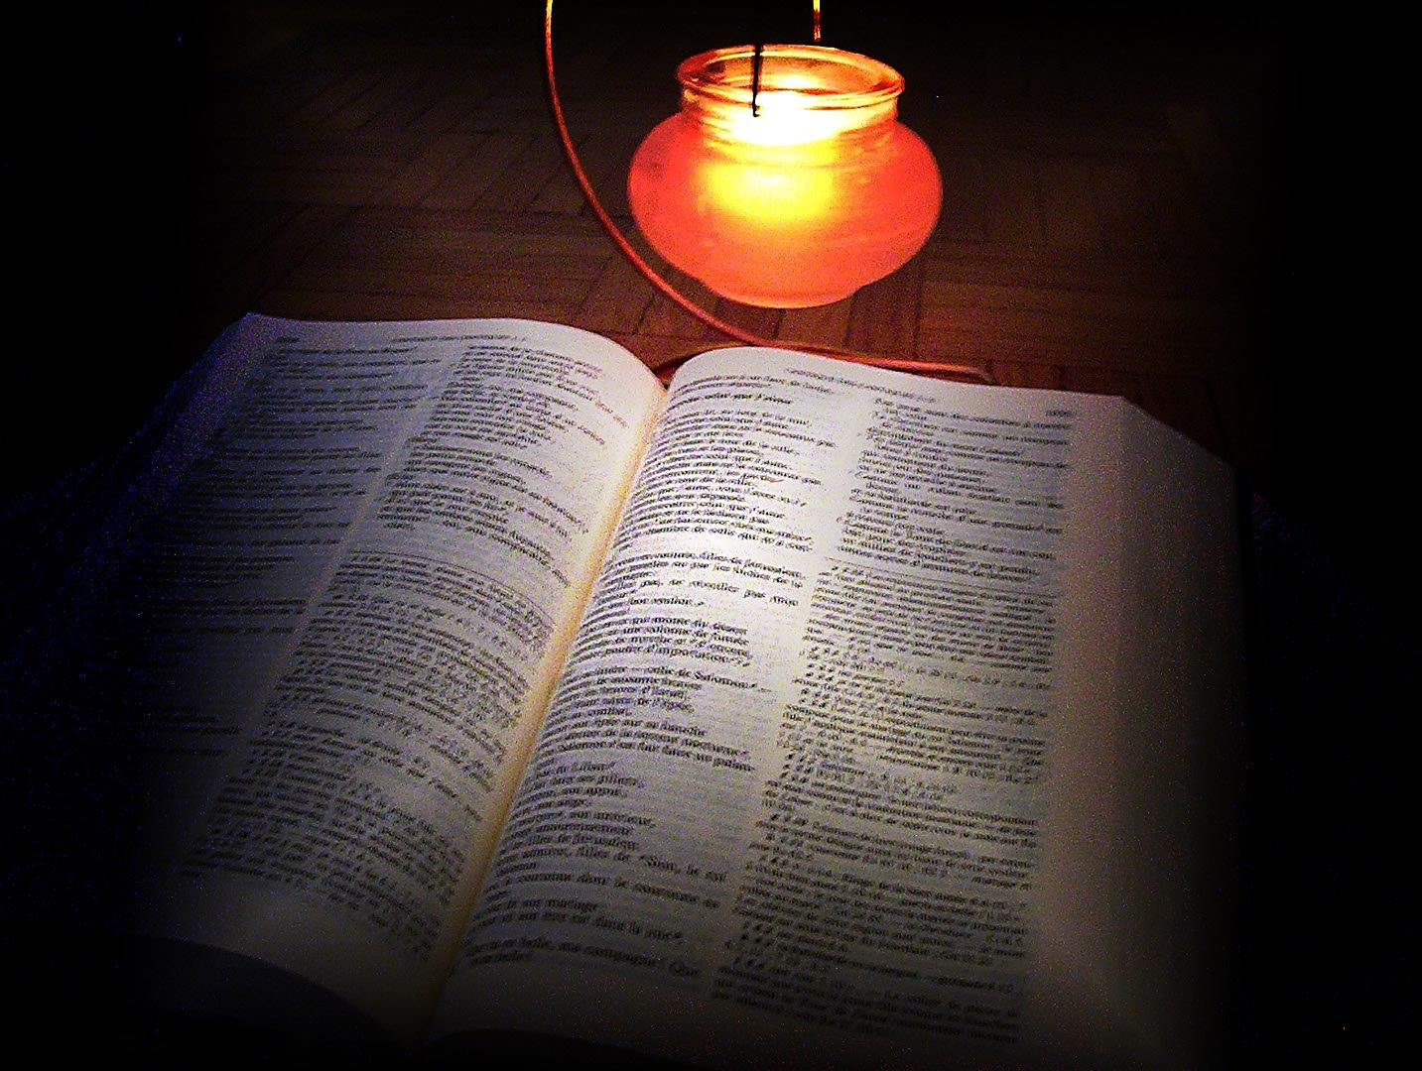
…..in God’s Word

Slide 7
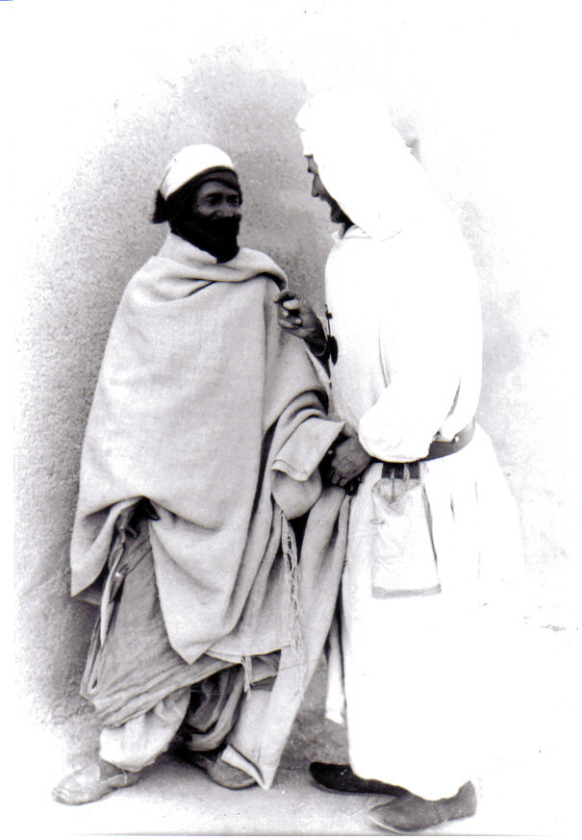
and in his presence
in every human person
especially the poorest
and furthest to reach.

Slide 8
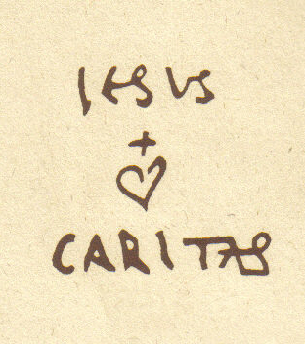
The heart of his message is LOVE:
‘It is Love which should help you live in me and not distance from my children’ .

Slide 9
Charles de Foucauld was born in Strasbourg in Alsace on the 15th September 1858

Slide 10
It helps to understand the beginning of his story to know that in 1864 when he was only six, he and his sister Marie
lose both their parents and become orphans.

Slide 11
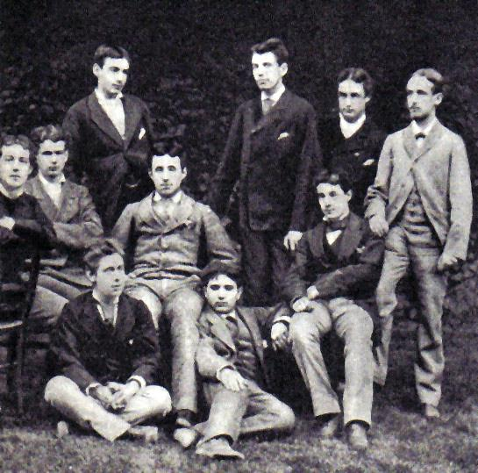
At high school Charles loses his faith.
He is between 16 - 17 years old.
His friend Gabriel Tourdes also loses his faith. Charles writes:
‘I forgot how to pray.’

Slide 12
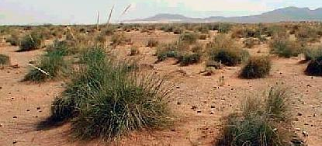
Charles’s life is in turmoil. After training in the army he is sent o North Africa. But something is changing in him. He gets on well with the other soldiers and he loves North Africa.

Slide 13
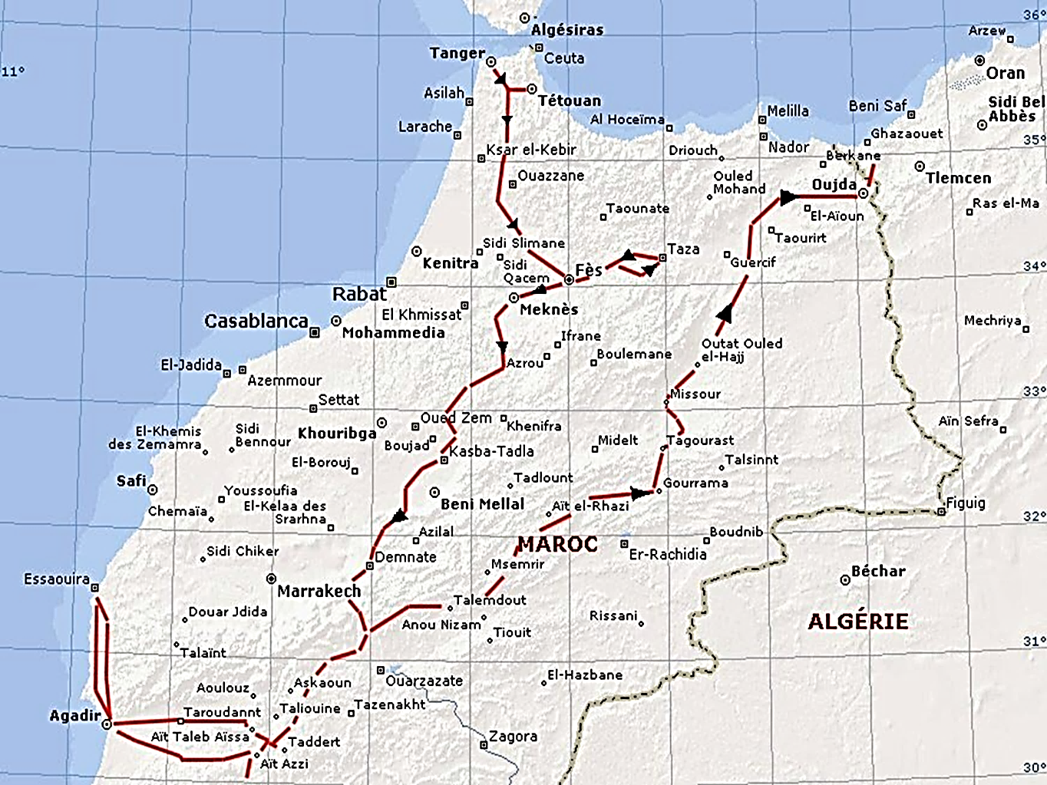
Eventually he leaves the army and undertakes to explore Morocco, which was a completely closed country at that time.
Charles calls us too to be open to what is new and different.

Slide 14
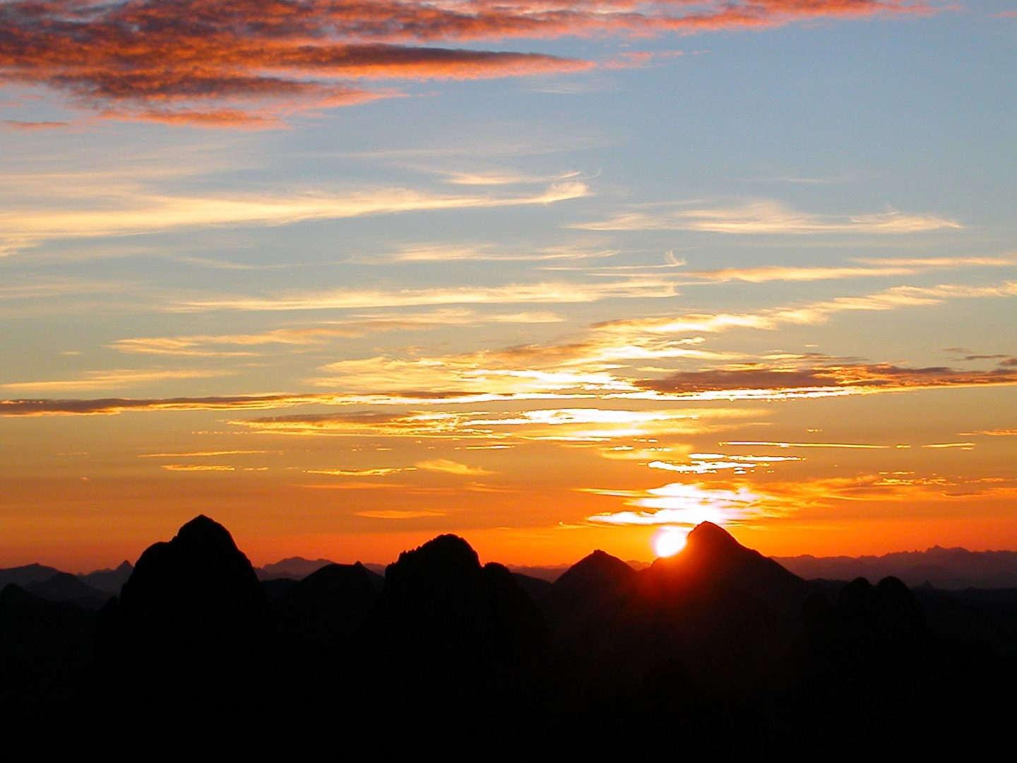
Charles explored Morocco disguised as a Jewish Rabbi.
His reawakening to faith in God was triggered by his experience of the faith and friendship of both Jews and Muslims.

Slide 15
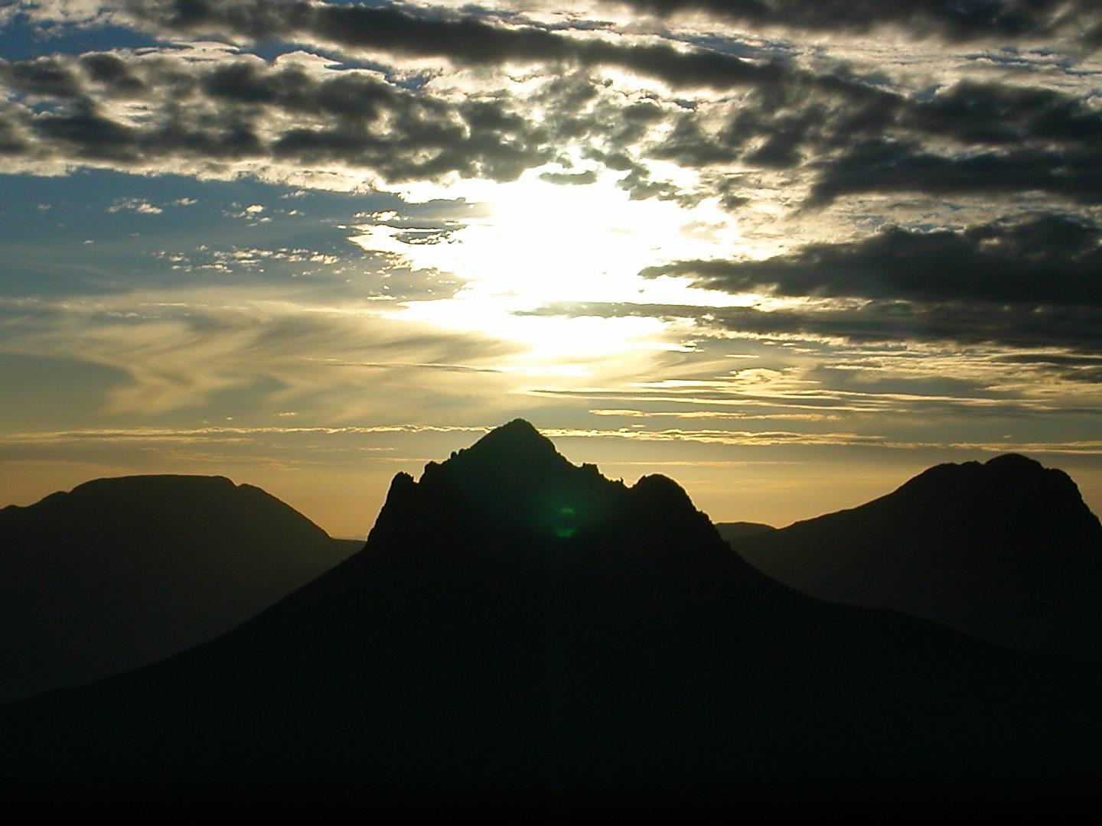
He rediscovered through their witness the greatness of God.

Slide 16
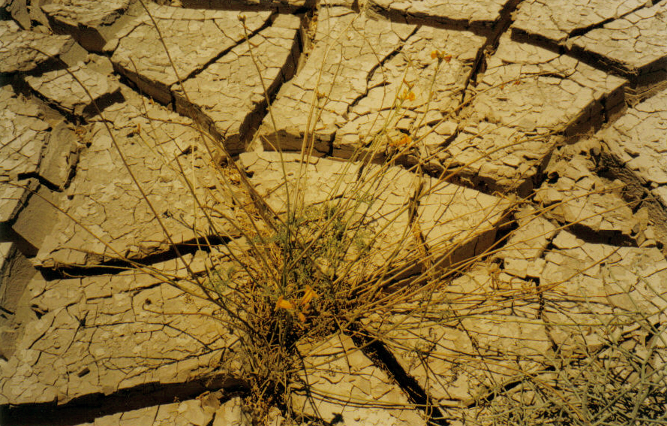
He would pray:
‘My God, if you exist help me to know you.’

Slide 17
Towards the end of october 1886, he returned to France and searched for a priest who could instruct him in the Catholic faith.
He met Father Huvelin in Paris.
December 1889
Charles is 31 years old

Slide 18
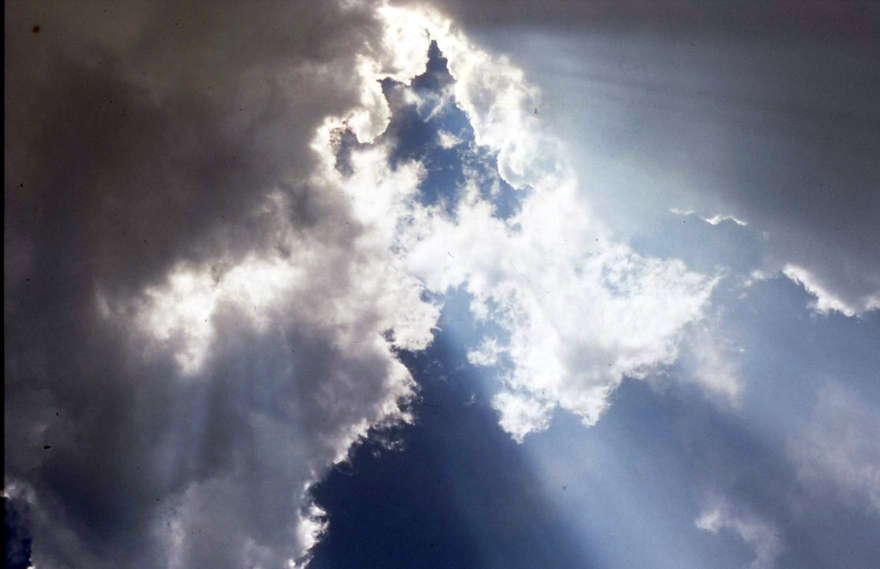
It is a turning point
He hands over his life to God. He kneels down, confesses his sins and receives Holy Communion.

Slide 19
‘As soon as I believed that there was a God, I understood that I could not do otherwise than to live for him alone.’

Slide 20
After his return to the faith Charles leaves for the Holy land to walk
in the footsteps of Jesus.

Slide 21
I have lost my heart to this Jesus of Nazareth crucified 1900 years ago and I want to spend my life seeking to imitate him, in so far as my weakness allows me.’
To Gabriel Tourdes, 1901

Slide 22
Nazareth today
‘I have set out to follow Jesus, God himself, who in Nazareth, “chose the lowest place.”

Slide 23
Trappist monk
1890 - 1897
Wanting to follow Jesus ever more closely he chooses to become a Cistercian monk.
.
On the 15 January 1890 he leaves for Our Lady of the Snows in France.
He moves to Syria, near Akbes, to a very poor monastery lost in the mountains, inhabited by Kurds, Armenians, Turks and Arabs.

Slide 24
In 1891,
he renounces his grade as an officer in the army and like St Francis leaves all his possessions to his sister.

Slide 25
He continues his search…..
He soon begins to question if he will be able to fulfill his ideal of poverty and of the hidden life following Jesus of Nazareth, at the monastery.

Slide 26
A long awaiting
June 1896 – 23 January 1897
‘I am dreaming of another form of Nazareth’.
In June 1896, as the date to take his final vows draws closer, he asks to be relieved of his vows.
He draws up plans for a new Religious Community.

Slide 27
Nazareth 1897 - 1900
He is 38 when he leaves the monastery. He travels back to Palestine
‘I spent almost four years with the Poor Clares as a servant and sacristan.’

Slide 28
In Nazareth, he sets out to live the life of Jesus of Nazareth as he imagines it.
He lives in a wooden hut in the garden of the Poor Clares.

Slide 29
From 1899 onwards he changes his signature and calls himself:
Brother Charles of Jesus.
He writes a first edition of the rule
for the ‘little brothers’
Icon painted by Brother Charles

Slide 30
‘JESUS, The One and Only Model’.
‘shout the Gospel from the rooftops, not through words but by your life, following Jesus of Nazareth: ‘

Slide 31
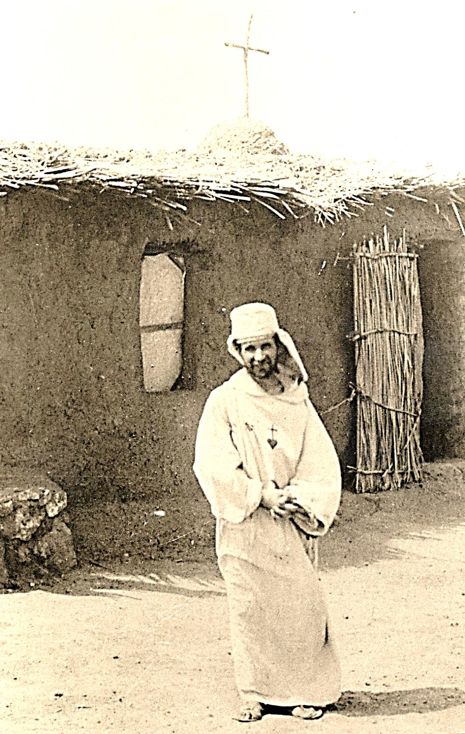
Let us too ‘cry out’
the Gospel through all
we do and say.

Slide 32
Love for the Eucharist and the urgent need
to give his life
in union with Jesus
push him
to become a priest.
Back in France he is ordained
on the 9 June 1901.
With his nephew Charles de Blic
At the time of his ordination.

Slide 33
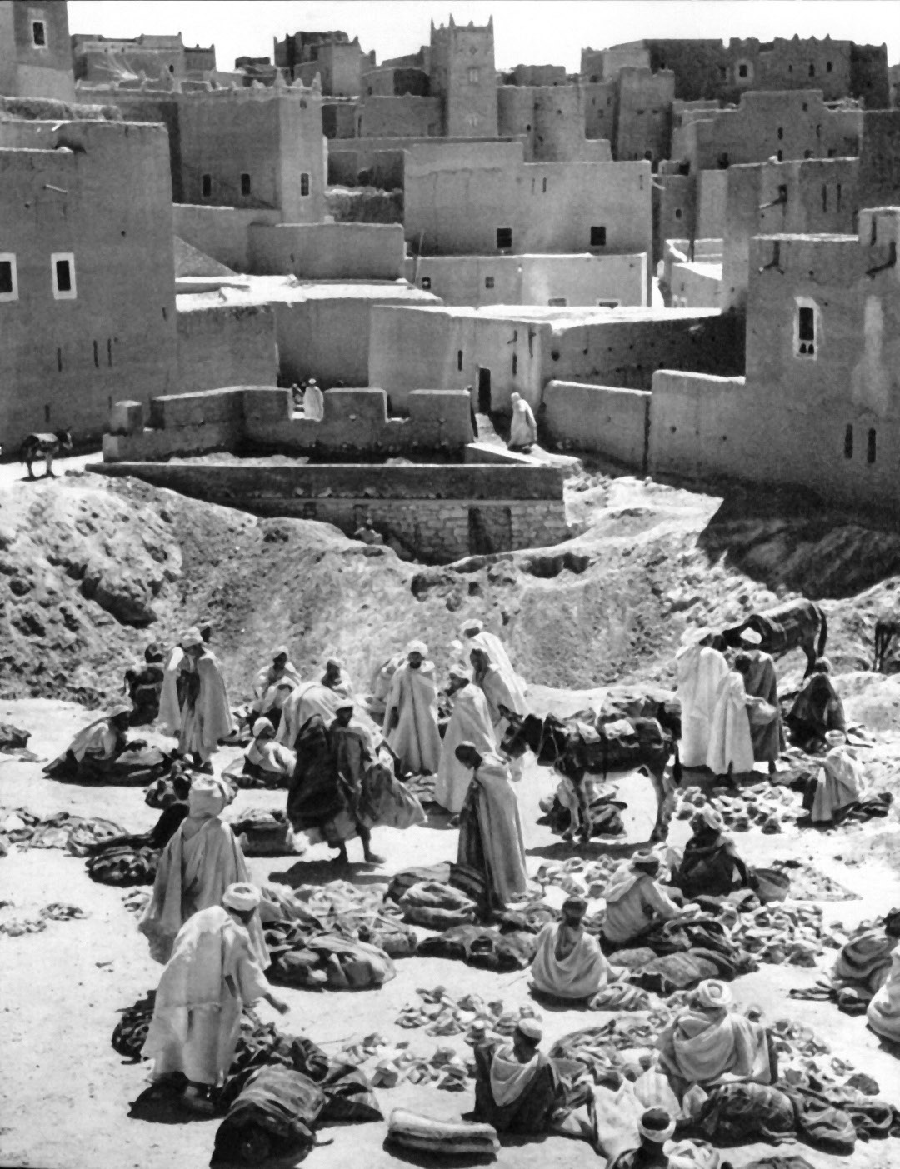
He thinks first of all of the people of Morocco but it is still a closed country.
He decides to return to Algeria,
‘to bring Jesus to those who are the farthest to reach’.

Slide 34
1901 - 1905 He settles in Beni-Abbes
Charles’ chapel

Slide 35
The ‘fraternity’ of Beni Abbes Sketch by Brother Charles.

Slide 36
He spent many hours praying before the Eucharist, but his door was open to all who knocked.
Whoever called was welcomed, above all the poorest.

Slide 37
On the 16th April 1902 he began to build an enclosure but he never finished it: love and availability took first place.

Slide 38
‘From 4.30 in the morning to 8.30 in the evening I never stop seeing and talking with people.’
To Marie de Bondy, 1902

Slide 39
Eucharist and a Love for others are but one Love!

Slide 40
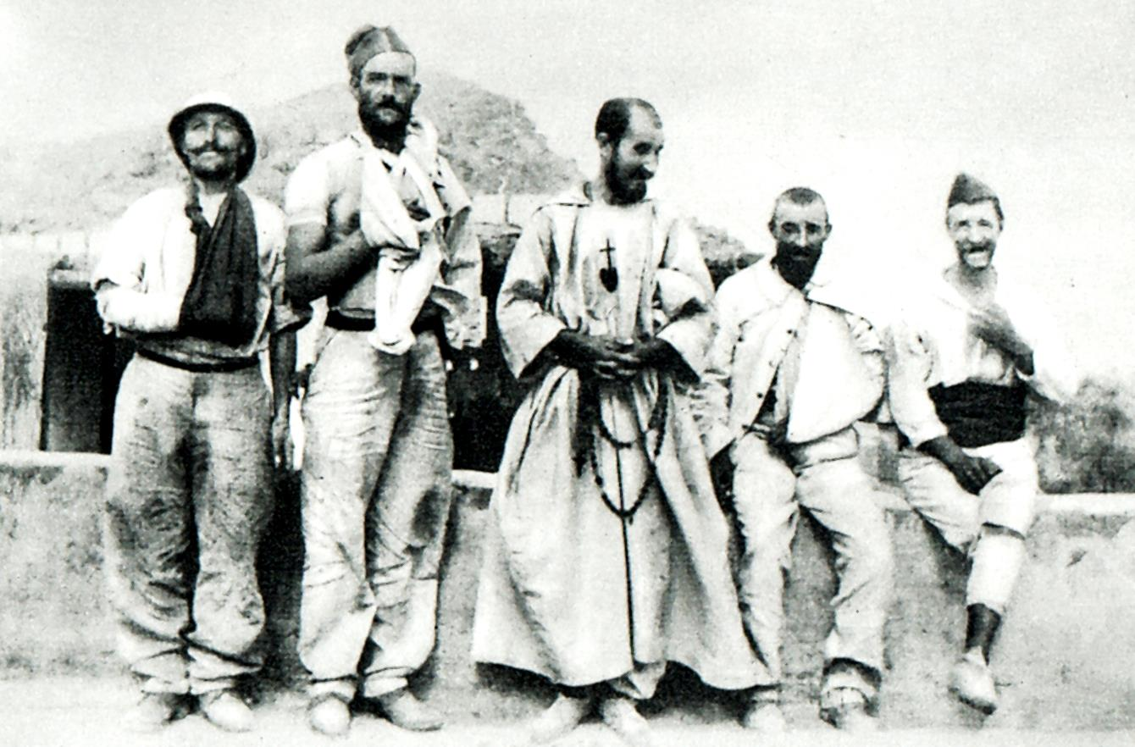
‘ I want everybody, Christians, Muslims, Jews and pagans to consider me as their brother, a universal brother. They begin to call my house the fraternity – «khaouia» in Arabic, and this makes me very happy’.
To Marie de Bondy,

Slide 41
His secret was his great love for Jesus, and his desire to hand over his life as Jesus did, for love of us.
‘Live today
as if this evening you will die as a Martyr’.

Slide 42
To express this love
for all,
he painted the Sacred Heart
to hang
behind
the altar
in his
little chapel.

Slide 43
He longed to have compagnons to bring this good news to all, but nobody stayed.

Slide 44
1902
He was outraged by the evil of slavery and reported it with indignation to both friends and civil and religious authorities, but without much success.

Slide 45
Every day he received soldiers, nomads, travellers but above all, slaves.

Slide 46
On the 9th January 1902 he officially freed a first slave, having obtained money from his family. Others would follow.
Attestation for release

Slide 47
With Paul Embarek who followed him to Tamanrasset and the little Abd-Jesu.

Slide 48
But he is still not settled:
‘I am often thinking of the ten million people of Morocco – who are just on my doorstep. They are without a single priest.’
To Father Guerin, 1902

Slide 49
‘For the spreading of the Gospel I am ready to go to the ends of the world and to live to the day of judgment...
I want only one thing and that is to do whatever pleases my God the most.’
To Father Guerin, 1903

Slide 50
In the steps of the Tuareg 1904-1905

Slide 51
Morocco remained closed, but following civil and military convoys, he crosses the desert and meets the Tuareg, Berber nomads from the South of the Sahara.

Slide 52
He realizes that this people have never had the opportunity to meet with Christianity. He longs to go and live among them. He learns Tamahaq, and starts to translate the Gospel into their language
The Holy Gospel in Tamahaq

Slide 53
1905 - 1916 Friend of the Tuareg
In 1905, he meets the head of the Tuareg of the Hoggar, Moussa Ag Amastane and he is welcomed as a guest toTamanrasset, a village of twenty huts.

Slide 54
Charles becomes a true friend to Moussa:
‘Moussa is an exceptional leader: He is much loved in his territory...’
To Father Guérin, 1905
Moussa Ag Amastane

Slide 55
Among the Tuareg, entering into their culture and way of life

Slide 56
Tifinagh,
Tuareg writing

Slide 57
‘I have chosen to live here in this hidden place and to make it my home. I beg Jesus to bless the place where I want to follow, as my only model, his life of Nazareth.’ Diary 1905
Tamanrasset – Charles’ first zriba

Slide 58
‘To live here alone is good: I can intervene without coming across as someone important, because I have become ‘as one of the locals’ . I am accessible to all and very little.’
To Father Guérin, 1907

Slide 59
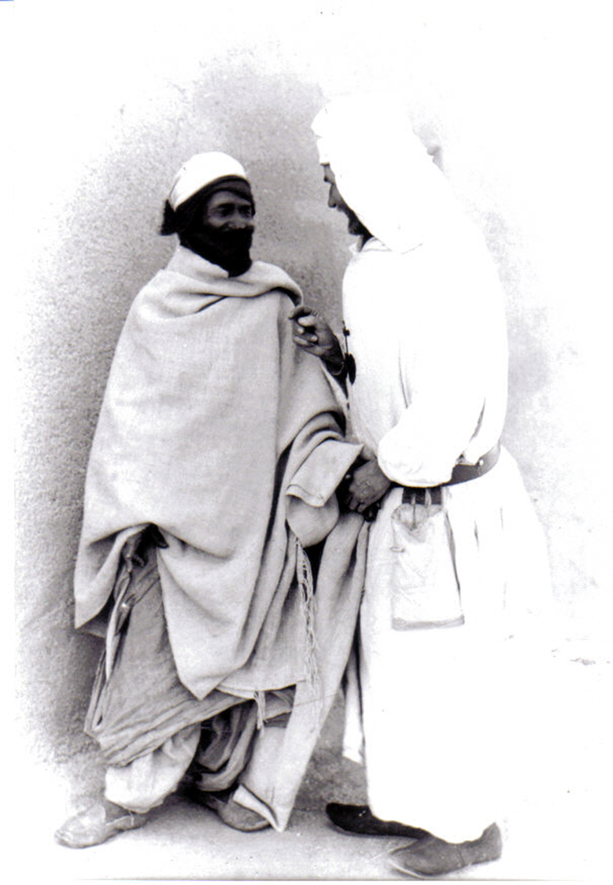
‘My apostolate is one of goodness.
If only you knew how good my master Jesus is!
Diary, 1909

Slide 60
The fraternity of Tamanrasset under construction.
Charles’ first home in the village made from mud bricks dried in the sun.

Slide 61
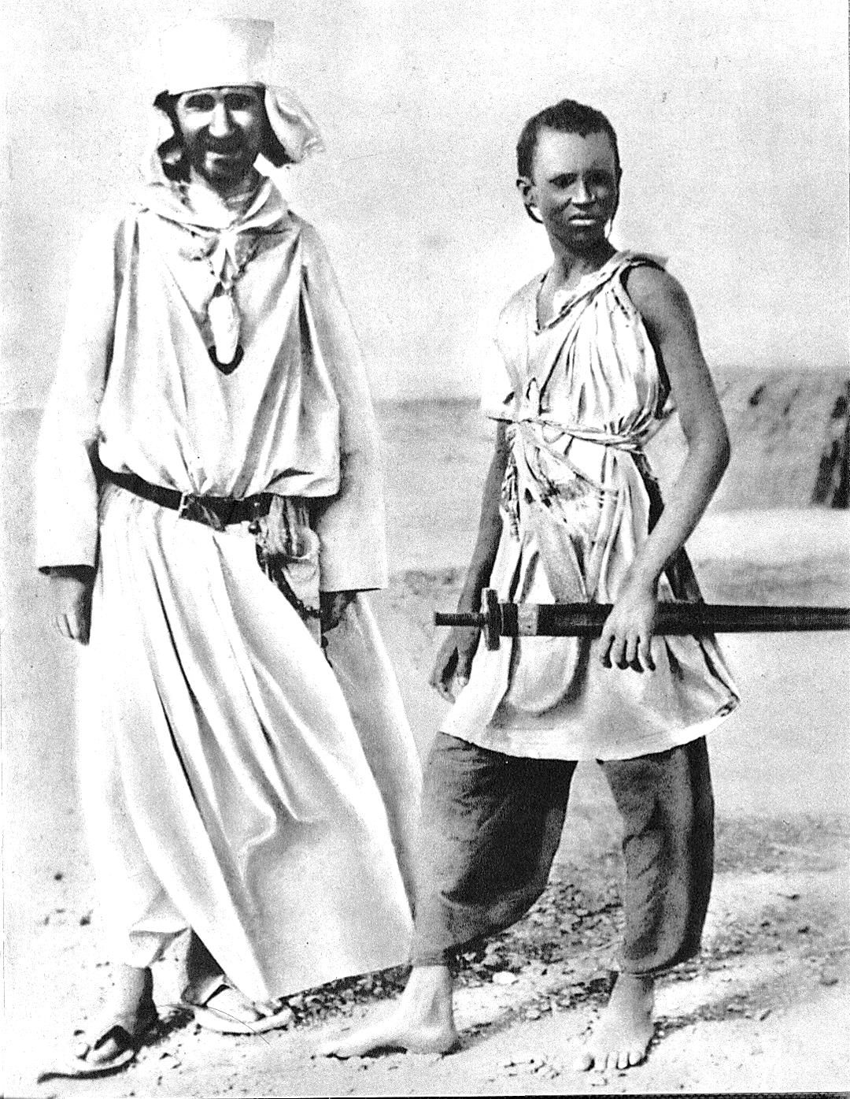
As Jesus came to live among us as one of us, so Charles lives among the Tuareg as one of them, sharing what they have and what he has.

Slide 62
Relationships of trust and friendship grow.
In 1907 he is alone and cannot celebrate Mass, as there are no other Christians present.
He chooses to stay despite this hardship.

Slide 63
He is attentive to each one and encourges them to live good and honest lives.

Slide 64
He spends time listening and writing down songs, poems and proverbs…He writes a very detailed Tuareg - French dictionary which has become the history of a people.

Slide 65
Two pages from his dictionary

Slide 66
Letters received from Tuareg friends
with comments
by Br Charles.

Slide 67
He returned to France
in 1909, 1911 and in 1913.
In 1913 he arrived accompanied
by the young Uksem.

Slide 68
He lived in faith, in hope and total trust in God’s love and compassion, waiting for even a single brother to join him.
He saw the need for:
‘fervent Christians from every walk of life,
who would bear witness to the Gospel by their lives.’

Slide 69
But he remained alone…

Slide 70
He lived with hope and trust

Slide 71
In 1911 he stayed several months in a hermitage on the Assekrem mountains.
He spent most of the time studying the Tuareg language with the secretary of Moussa Ag Amastane.

Slide 72
He gave hospitality to the nomads who came up the mountains with their flocks.

Slide 73
The chapel inside the hermitage looking over the mountains

Slide 74
‘The view is more beautiful than you could possibly describe or imagine.
In front of such a sight you cannot but think of God.’

Slide 75
Charles encountered Jesus in those who neither shared his religious world nor his culture.
Fired by the Gospel he was called to keep silent, in an infinite respect for the other, and to believe that it was through living Incarnation, living as Jesus had lived, that he was called to proclaim the Gospel.

Slide 76
Tamanrasset
Charles is getting older…
He continues to trust, putting his faith in God alone.

Slide 77
He longed for all people to meet in heaven, people of every race and religion.

Slide 78
He who dreamed of giving his life for others was to receive life from the Tuareg during a terrible time of drought when he was near dying from scurvy. The poor gave him life.

Slide 79
In 1914 war breaks out.. The Sahara is isolated and poverty increases among people already hit hard by famine.

Slide 80
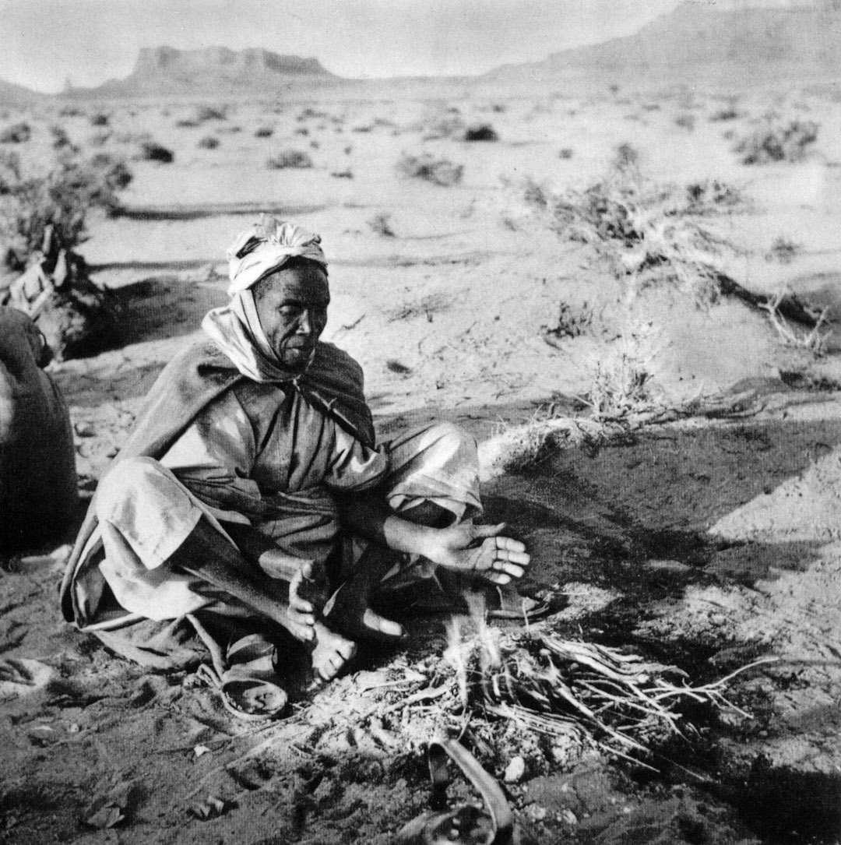
In Tamanrasset
the poorest stay behind: cultivators with small plots of thirsty soil, who do not possess camels.
Brother Charles stays with them. He belongs with them.

Slide 81
In 1915 Brother Charles
finishes copying the Tuareg – French dictionary: he had reached page 2028!
He still had to copy out the proverbs and poetry.

Slide 82
But the Sahara was like a tinder box: razzias in the west and rebel groups in the east.
To defend the poor he built a fortress-shop for the community – a casbah, like he had seen in Morocco.

Slide 83
He moves into the little fort in the summer of 1916

Slide 84
On the evening of the 1st December, a Friday, he was alone and waiting for the post to arrive.

Slide 85
The place of his death, showing the bullet hole in the wall facing us.
Hearing a knock at the door he half opened it... But it was not the mail:
A band of rebel Tuareg seized him and bound him, to take him as a hostage.
A young boy held him at gun point.

Slide 86
When two men arrived mounted on camels panic ensued.
The boy fired and Br Charles was shot and died on the spot at the door of the fort.

Slide 87
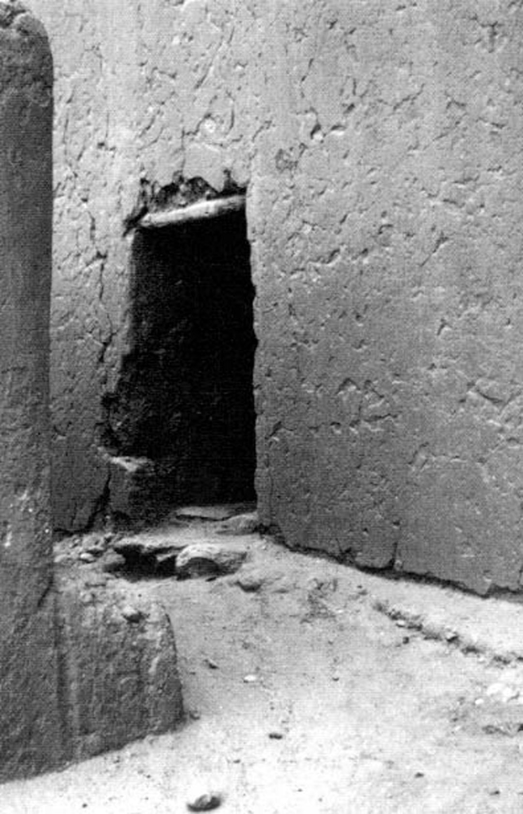
He had written several letters. These were found already stamped, on the 21st December 1916 when the pillaged fort was discovered.

Slide 88
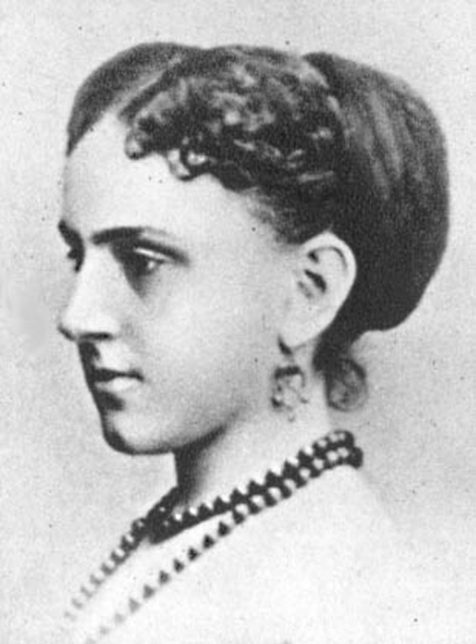
One was to his cousin Marie.
Brother Charles had written:
‘I know that God will welcome into Heaven all who are good and honest...’

Slide 89
Moussa, the Touareg Chief, in his letter of condolence to the family of Brother Charles wrote :
‘Charles…did not die only for you, he also died for us all. May God have mercy on him and may we meet in Paradise. ‘

Slide 90
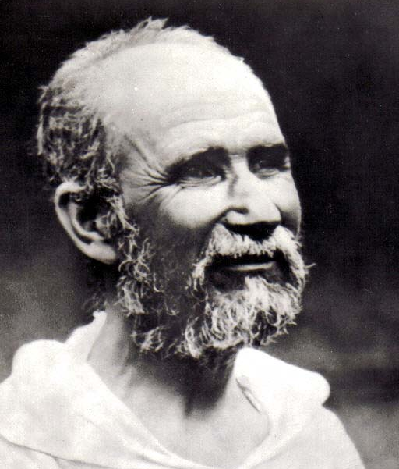
Charles’ story was a continuous journey towards true Life

Slide 91
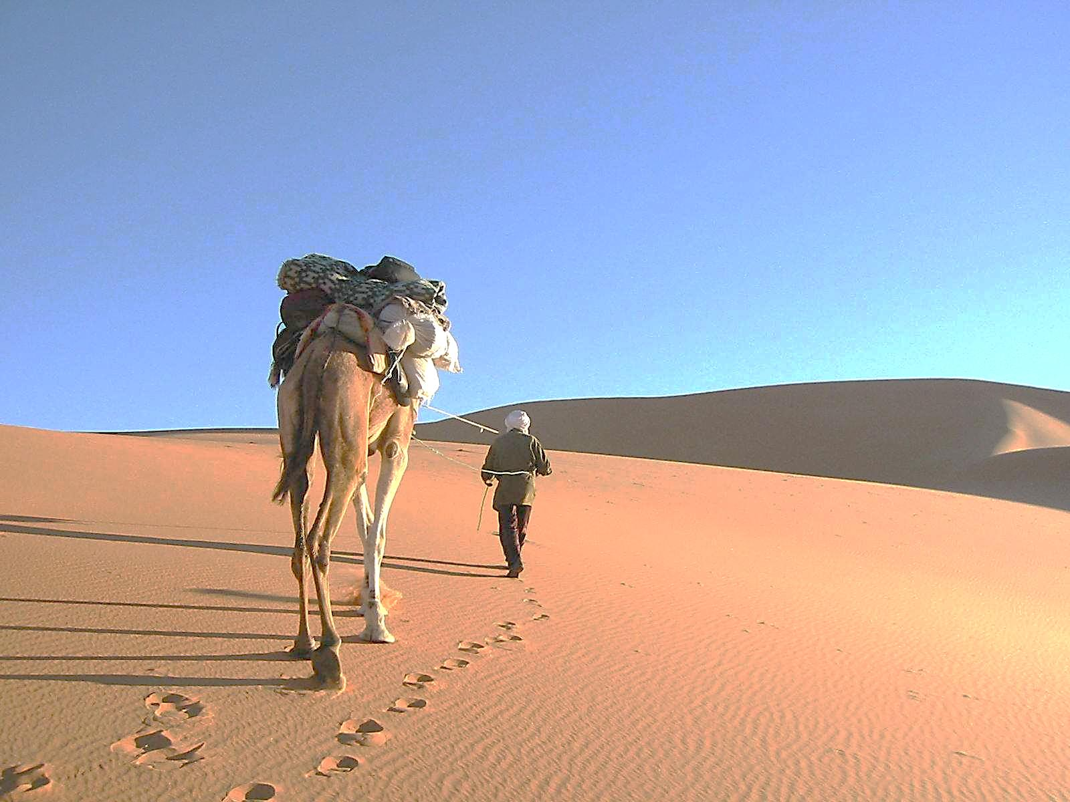
“Unless the grain of wheat falls into the ground and dies, it remains but a single grain,
but if it dies it brings forth much fruit.”
John 12.24

Slide 92
Charles de Foucauld
died alone
but as the grain that falls into good earth, his life and death have brought forth fruit in abundance...

Slide 93
And so it was that on the 13 November 2005
Charles became Blessed Brother Charles of Jesus:
His ‘little way’ was recognized by the Church.
Rome, St Peter’s Square

